Slide 1
D2D communications in 5G cellular networks:
Prof. Preeti Godabole

Slide 2
Content
Introduction to D2D communications;
High level requirements for 5G architecture;
Introduction to the radio resource management, power control and mode selection problems;
Millimeter wave communication in 5G.

Slide 3
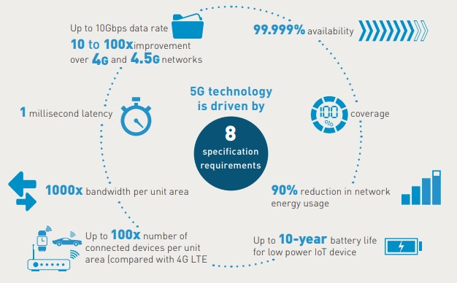
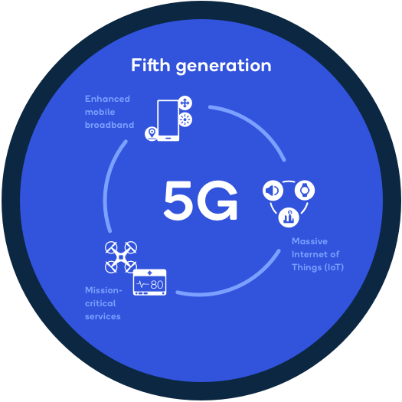
What is 5g… Specification requirement
5G wireless technology is meant to deliver higher multi-Gbps peak data speeds, ultra low latency, more reliability, massive network capacity, increased availability, and a more uniform user experience to more users. Higher performance and improved efficiency empower new user experiences and connects new industries.

Slide 4
Where is 5g used
Enhanced mobile broadband
In addition to making our smartphones better, 5G mobile technology can usher in new immersive experiences such as VR and AR with faster, more uniform data rates, lower latency, and lower cost-per-bit.
Mission-critical communications
5G can enable new services that can transform industries with ultra-reliable, available, low-latency links like remote control of critical infrastructure, vehicles, and medical procedures.
Massive IoT
5G is meant to seamlessly connect a massive number of embedded sensors in virtually everything through the ability to scale down in data rates, power, and mobility—providing extremely lean and low-cost connectivity solutions.

Slide 5
Challenges that follow..
5G wireless has been assigned a new spectrum in low and mid bands (up to 6 gigahertz [GHz]) and in high bands (with millimeter wavelengths above 24GHz).
Challenge for 5G antenna designs
Some devices need to operate in multiple bands.
Another is that millimeter wavelengths transmitted at cellular network power levels are subject to higher absorption by buildings, vegetation, and raindrops than low and mid bands.
This limits millimeter wavelength communications to line of sight, which necessitates small cell networks that can increase chances of edge interference between cells.

Slide 6
Meeting 5G NR objectives requires new antenna designs
active antenna arrays to provide better coverage, reduce interference, and increase data-carrying capacity.
To operate in its full range of assigned frequencies,
5G NR uses a scalable framework that functions at frequencies between 450 megahertz (MHz) and 6GHz (frequency range 1 [FR1]) and between 24.25 and 52.6GHz (frequency range 2 [FR2]).

Slide 7
5g on existing LTE
5G NR does this by using scalable orthogonal frequency-division multiplexing (OFDM) waveforms that allow different subcarrier signal spacing to fit the various channel widths that different frequency ranges provide.
Higher frequencies provide wider channels and greater subcarrier spacing.
Lower frequencies use smaller channel widths and narrower subcarrier spacing.
Scaling subcarrier spacing to available channel widths enables the 5G framework to operate across a broad range of frequencies.
The result makes it possible to deploy 5G in existing 4G Long-Term Evolution (LTE) networks.

Slide 8
Device Density, Data Throughput, and Massive MIMO
challenge presented by the 5G specification is the need to support much higher densities of connected devices that are operating simultaneously at much higher data rates.
require higher cell densities and more extensive use of the multiple-input, multiple-output (MIMO) antenna technologies already in use in 4G LTE networks.
MIMO is an antenna array of multiple transmitting and receiving antennas (which in current LTE networks, often contains an 8 x 8 antenna array).
MIMO uses spatial multiplexing to break a signal into encoded streams that it simultaneously transmits through different antennas in the array.

Slide 9
Communicate with multiple users and devices simultaneously.
Communicate with higher throughput
Many variations of MIMO exist. A key variation for 5G is massive MIMO (mMIMO), an antenna design that packs many more antenna elements into a dense array than previous MIMO versions.
Millimeter wavelengths work with much smaller antennas, which makes it possible to build mMIMO arrays in small packages.
Beamforming, Directionality, and User Equipment Tracking
High frequency (millimeter wavelength) 5G deployments will take advantage of adaptive arrays using larger mMIMO antennas with many more antenna elements and capable of tighter beamforming and real-time steering.

Slide 10
Communicate with multiple users and devices simultaneously
Downlink and Uplink Requirements
The 5G specification facilitates a maximum downlink data rate that is twice the uplink data rate in given use cases. In current deployment phases below 2.6GHz, 5G requires at least a 4 x 4 downlink MIMO and recommends at least a 2 x 2 uplink MIMO.
Antenna Designs for Different Use Cases
5G deployments will require many antenna packages for indoor and outdoor use, small cell and macro-coverage, and many different kinds of terminal equipment.

Slide 11
Communicate with multiple users and devices simultaneously
Base Stations
Most cell phone towers today are highly congested. Building compact 5G antennas that integrate lower and higher frequencies is the most cost-effective solution.
In addition, placing antennas on light poles and corners of buildings for small cell coverage will require compact designs. Several telecom operators have begun deploying small 4G cells to address bandwidth and latency issues.

Slide 12
User and Terminal Equipment
Data, communication requirements, operational frequencies, and equipment design will dictate antenna designs in different 5G applications.
Cell Phones
Cell phones are already packed with antennas, so adding antennas to support the full range of 5G frequencies will be a challenge.

Slide 13
The Challenges of 5G Antenna Design
Antenna designers typically begin with antenna simulation software
A significant challenge in 5G antenna designs is antenna testing.
5G antennas are not static, omnidirectional devices. They are active, and they beam their transmissions to specific devices.
Putting a 5G antenna in a test room and applying a static test does not show how it will perform when it is simultaneously communicating with a thousand moving devices in a noisy RF environment.
Most antenna designers are not sure of the most effective means to test or validate performance for devices that use mMIMO arrays.
Testing methods will likely involve scenario-based automated testing.

Slide 14
M2M, IoT,D2D
IoT and M2M, both refer to the interconnection and sharing data between devices with embedded chips, sensors.
There is a distinction between them.
IoT is a broader system of devices where every device has an IP address and can communicate over the internet platform
M2M concentrates on the direct flow of information between two devices and supports a point-to-point connection.
An example of M2M could be a revolutions per minute (RPM) sensor on a mill sending data directly to only one smartphone.
M2M also ships with some security features because of its characteristics:
End-to-end encryption because the communication is established between 2 devices.
When hackers attack, only information between some pairs of devices can be jeopardized.

Slide 15
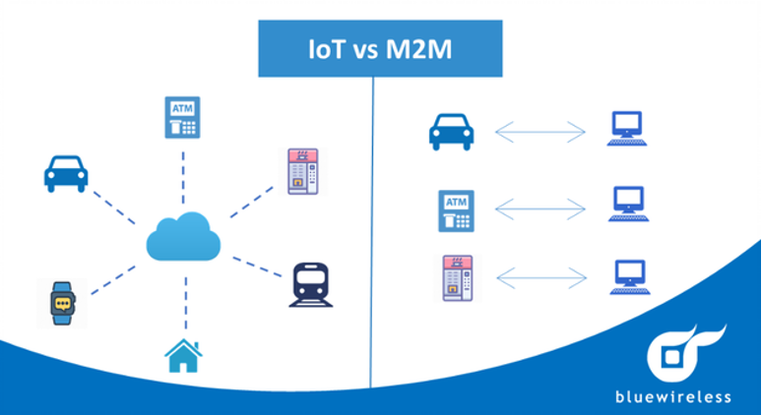
IOT vs M2M

Slide 16
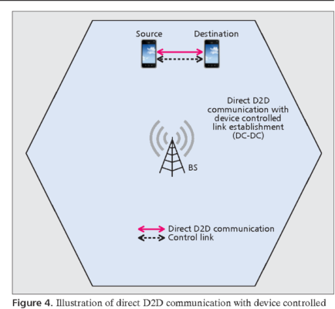
D2D communication
The cellular network is one of the most blooming technologies recently with its fifth-generation (5G) which provides faster connectivity to the internet.
Newer applications are introduced to the market and require fast multimedia-rich data exchange and the number of subscribers soared due to the popularity of smartphones.
All of that huge data transfer required to travel through the base station or the core network which might create latency.
D2D communication allows devices in close proximity to transfer data by creating a direct link and does not require that data to go through the base station.

Slide 17
D2D with existing technologies
To enable D2D communication, we can rely on some existing wireless technologies used for transferring data in the near areas such as
Bluetooth,
WiFi direct
LTE direct.
The listed wireless technologies however offer different ranges and speeds:
Bluetooth 5.0 offers a maximum data rate of 50Mbps and a range of 240m
WiFi Direct offers a 250 Mbps data rate and a range of 200m
LTE Direct offers up to 13.5 Mbps data rate and a range of 500m

Slide 18
Applications of D2D
D2D provides a quick way to send data between devices that are nearby without going through Base Station (BS). That characteristic makes it an effective technique in many scenarios.
Local data services: D2D communication is fit and suitable to provide local data services for a small group of devices. It can support sending from one device to another device (unicast), or group of devices (group cast), or all devices (broadcast).
Information sharing: by using D2D links we can transfer files, videos, audio with high speed but using lower energy like using cellular channels. When disasters occur, the base stations may be destroyed, however, the D2D links can still work.
Data and computation offloading: Devices can act as hotspots that contain the same data as BS. Other devices with lower batteries then can get the data of those hotspots.
Machine-to-machine communication: Devices can leverage the power of D2D communication to directly transfer data with lower energy required and ultra-low latency. In some cases, M2M communication requires real-time data to be transmitted.
Automation cars need to exchange data with other nearby cars as fast as possible to make a decision instantly.

Slide 19
Mode selection and resource allocation
The concept of D2D communications is to allow direct communications among the user equipment's (UEs) by reusing the cellular resources rather than using the uplink or downlink resources of the cellular networks .
D2D communications can achieve four types of gain , namely proximity gain, hop gain, reuse gain, and pairing gain. In D2D communications, the UEs can operate in one of three traditional modes as follows.
• Reuse mode: D2D UEs directly transmit data among themselves by reusing some radio resources used by cellular UEs to enhance the spectrum utilization.
• Dedicated mode: D2D UEs directly transmit data among themselves by using a dedicated portion of spectrum to avoid interference with cellular UEs.
• Cellular mode: Similarly to cellular UEs, D2D UEs relay their data through the base station.

Slide 20
how to select a transmission mode?
In the cellular mode, more resources (e.g., the number of time slots) may be required for transmitting data to the receiver than in the reuse mode or dedicated mode;
however, it is easier to manage interference with cellular users. The reuse mode can achieve a higher spectrum efficiency but D2D communications in this mode may interfere with cellular users and other D2D users using the cellular mode.
By contrast, the dedicated mode can completely avoid interference, since some resources are reserved for the D2D communications; however, the spectrum utilization can be very poor in this mode.
A simple method is to choose the mode by considering only the received signal strength over the D2D link or the distance between the terminals.
However, the interference conditions and the differences between sharing cellular uplink and downlink also affect the overall network throughput.

Slide 21
Millimeter wave communication in 5g
high-frequency bands are often referred to as “mmWave” due to the short wavelengths that can be measured in millimeters.
Although the mmWave bands extend all the way up 300 GHz, it is the bands from 24 GHz up to 100 GHz that are expected to be used for 5G.
Modern 5G operates in the 3.5GHz frequency band that allows for higher capacity and lower latency.
To achieve even higher frequency, longstanding mmWave technology can be utilized for next generation connectivity.
Pairing 5G with mmWave provides massive capacity and even lower latency to unlock the full 5G experience.

Slide 22
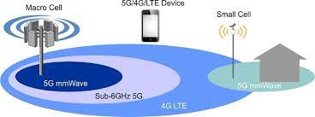
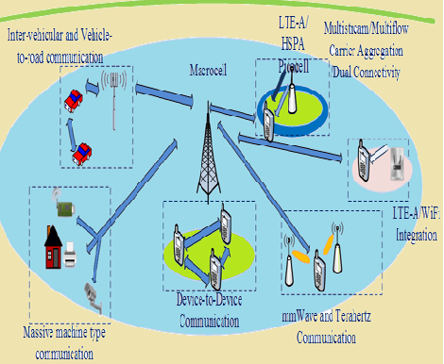
5g mmwave
Because of its high frequencies, mmWave has a limited range of only 300 to 500 feet and struggles to penetrate buildings

Slide 23
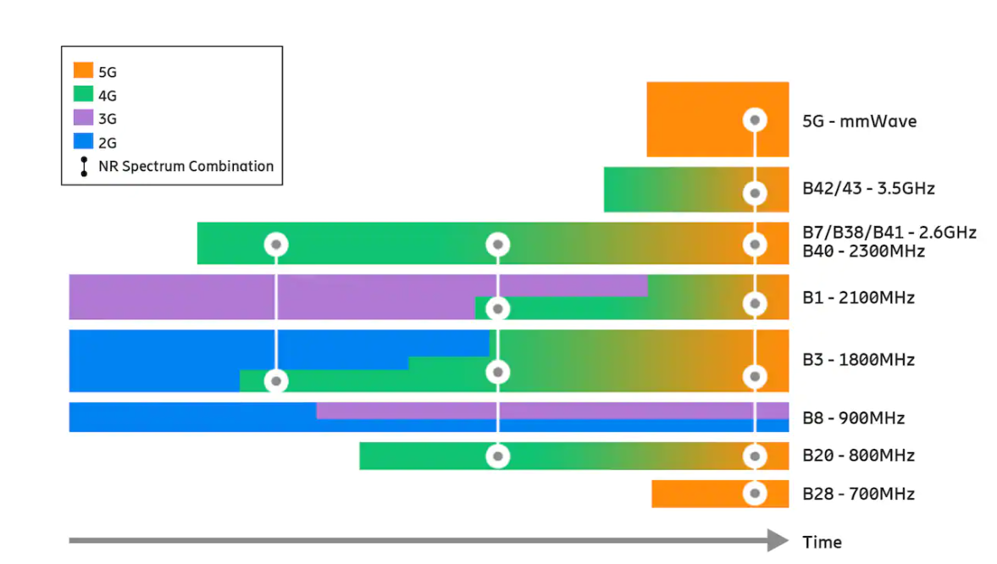
Mmwave 5g

Slide 24
Web references
https://www.qualcomm.com/research/5g/5g-nr/mmwave
https://www.cambridge.org/core/books/abs/wireless-devicetodevice-communications-and-networks/mode-selection-and-resource-allocation-for-d2d-communications-underlaying-cellular-networks/77DB55E7E07FCE938A355CD4D6D538A0
https://www.wevolver.com/article/5g-antenna-design
https://www.speranzainc.com/what-is-machine-to-machine-device-to-device-internet-of-things/#:~:text=While%20IoT%20refers%20to%20a,of%20Machine%2Dto%2Dmachine.

